Slide 1
Project On a Banking Application Using JavaFX
The project explains the development of a micro-finance bank desktop application that simulated the banking front desk operations using JavaFX.

Slide 2
PROJECT TOUR
ADMIN DASHBOARD
STAFF DASHBOARD
Admin Portal
Staff Portal
LogIn
Window
Notes:
This is the login screen

Slide 3
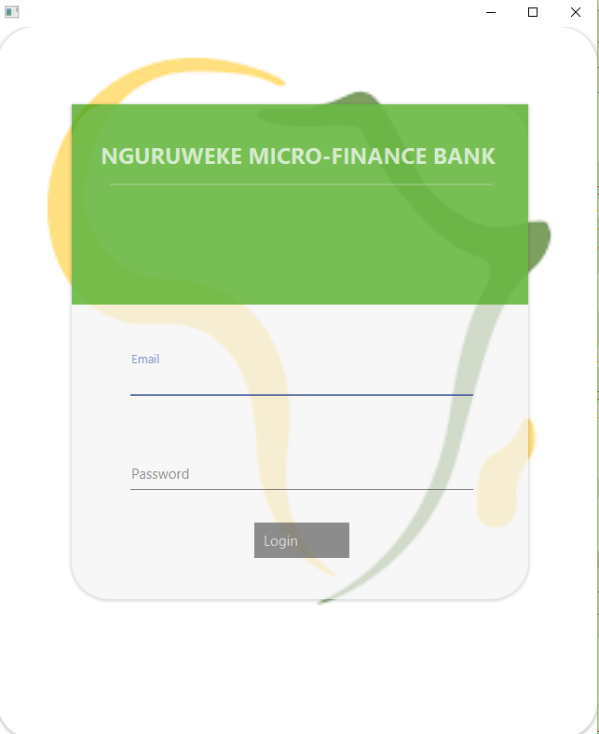
THE LANDING PAGE OF THE
USERS COULD BE
IS A LOG IN VIEW FROM WHICH
ADMIN
USERS ARE REDIRECTED TO ATTRIBUTED ROLES
or
STAFF

Slide 4
ON LOGGING IN
ON LOGGING IN, A SCENE IS SET FOR EACH USER BASED ON THE ROLE ATTRIBUTED FOR THAT USER

Slide 5
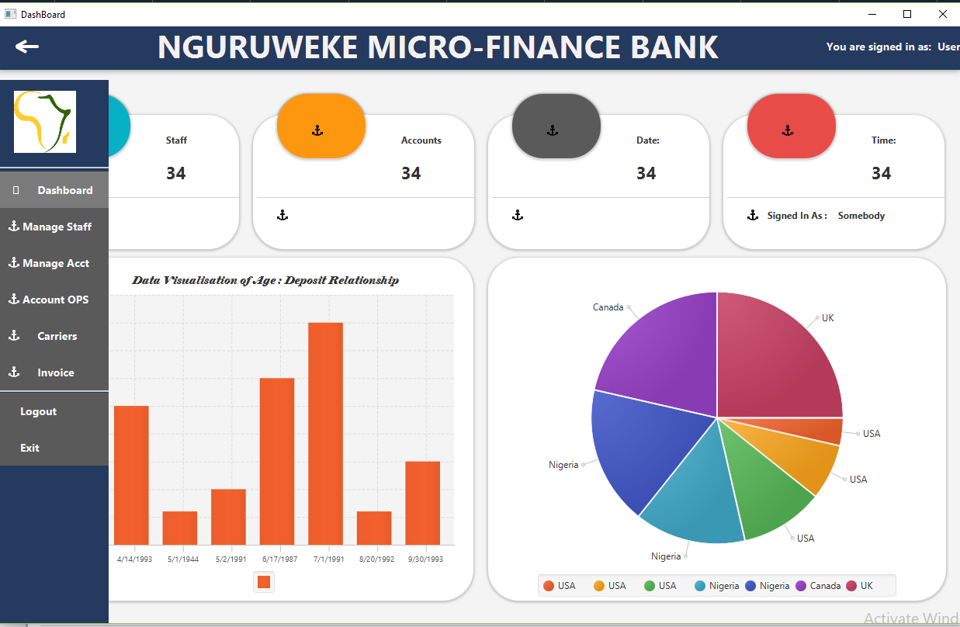
FOR ADMIN USERS: VIEW SET IS:

Slide 6
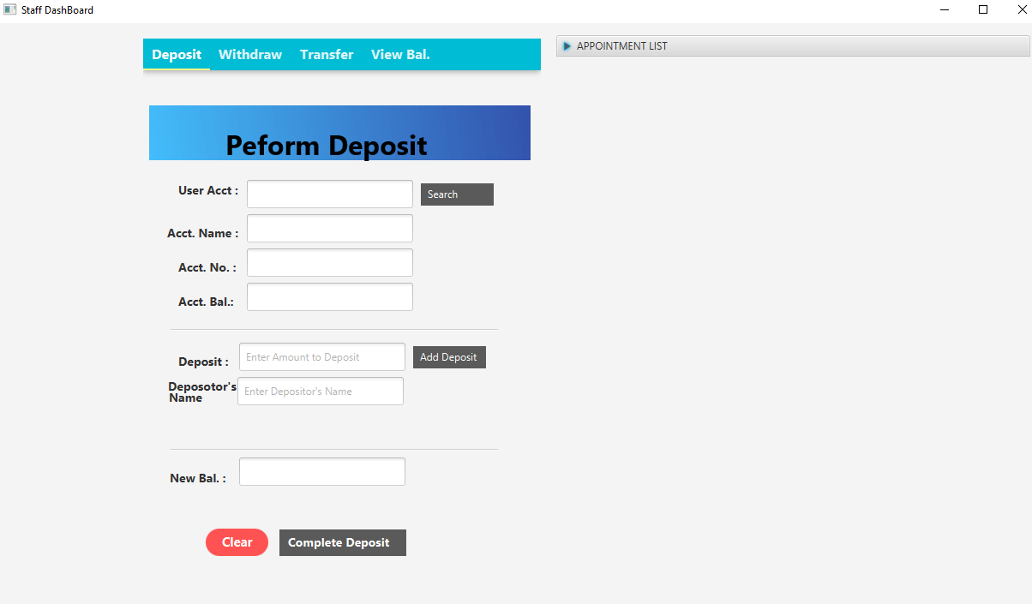
FOR STAFF USERS: VIEW SET IS:

Slide 7
OPERATIONS PERFORMED BY ADMIN USERS INCLUDE
STAFF MANAGEMENT: Adding a Staff,Deleting,Updating and Viewing Staff Details.
ACCOUNT MANAGEMENT: Creating an Account,Deleting,Updating and Viewing Acount Details.
ACCOUNT OPERATIONS: This include, WITHDRAWALS,DEPOSITS,& TRANSFER OPERATIONS

Slide 8
OPERATIONS PERFORMED BY STAFF USERS INCLUDE
ACCOUNT OPERATION
Withdrawals, Deposits,Transfers
And View of Account Details

